Slide 1
beer pong
Team Cable

Slide 2
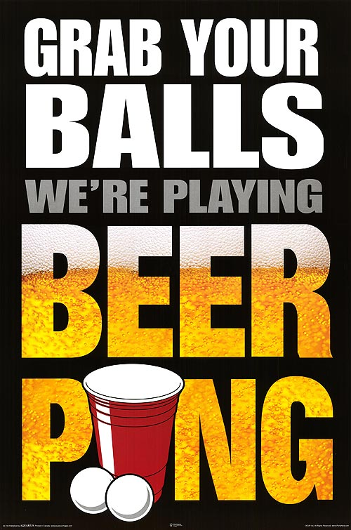
Main rules
There are 2 players
Each player has 10 balls
There are 6 cups on a table
The goal is to throw the balls into the cups
If one of the players gets one of the balls, the other one drinks
The game ends when
There are no balls left
One of them gets VERY, VERY drunk

Slide 3
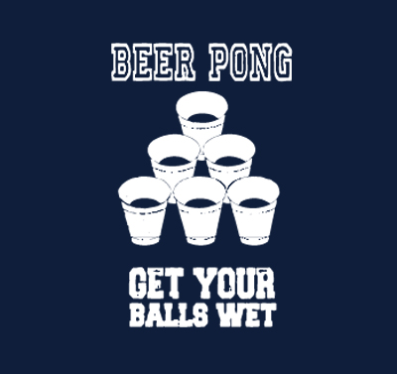
Scoring system
Each cup has a different size and difficulty level
The drunker you become, the harder it gets to score
The speed of the ball is adjusted according to the level of “drunkenness”

Slide 4
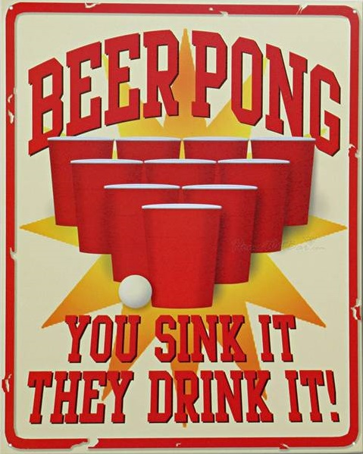
Let’s play!!!

